Slide 1

Covid-19 Dataset
Moaz Osama Elmorshedy
3/6/2024

Slide 2
Concepts
Q1. Write a code to check NULL values
Q2. If NULL values are present, update them with zeros for all columns.
Q3. check total number of rows
Q4. Check what is start_date and end_date
Q5. Number of month present in dataset
Q6. Find monthly average for confirmed, deaths, recovered
Q7. Find most frequent value for confirmed, deaths, recovered each month
Q8. Find minimum values for confirmed, deaths, recovered per year
Q9. Find maximum values of confirmed, deaths, recovered per year
Q10. The total number of case of confirmed, deaths, recovered each month
Q11. Check how corona virus spread out with respect to confirmed case (Eg.: total confirmed cases, their average, variance & STDEV )
Q12. Check how corona virus spread out with respect to death case per month (Eg.: total confirmed cases, their average, variance & STDEV )
Q13. Check how corona virus spread out with respect to recovered case (Eg.: total confirmed cases, their average, variance & STDEV )
Q14. Find Country having highest number of the Confirmed case
Q15. Find Country having lowest number of the death case
Q16. Find top 5 countries having highest recovered case

Slide 3
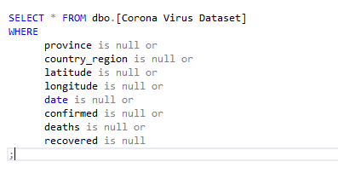
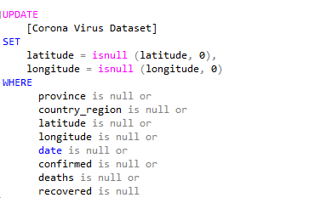
Question 1-2
As we see in question one, we select all from the database where have a null value as we have 35,865 Rows have a null values that are in Latitude or/and Longitude.
In question two we update all the null values with 0 with the command UPDATE 35,865.

Slide 4
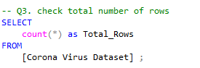
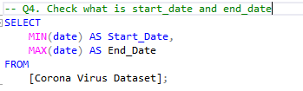
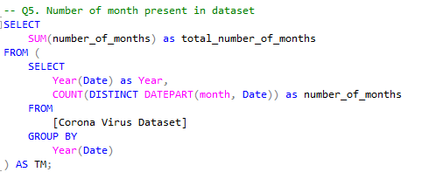
QUESTON 3-5
In Question 3
By using the count function the total rows are "78,386" Rows.
In Question 4
By checking the minimum value in (Date) as the Start Date and the maximum value in (Date) as the End Date
The start date 2020-01-22 and the End date 2021-06-13.
In Question 5
By using the count function for the months to know the total number.
As we defined from the nested query that the 12 for the year 2020 and 6 for the year 2021
The outer select get the total of the 2 years that is "18 months“.

Slide 5
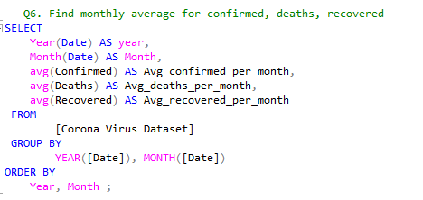
Question 6
By using The avg function and take the year and month from the date to know the average monthly for each year.
As the output are 18 rows each row for a month in a year.

Slide 6
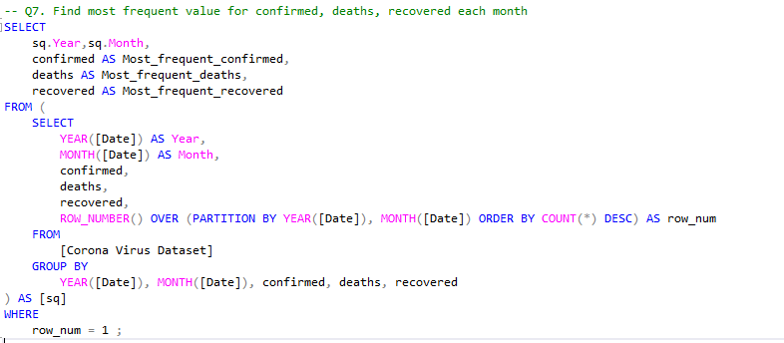
Question 7
As the output show that all values are zero as it seems that much days are no action for each case.

Slide 7
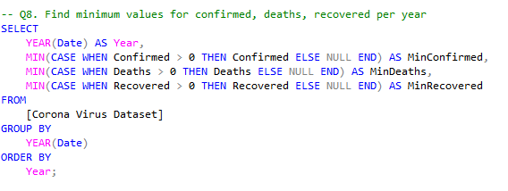
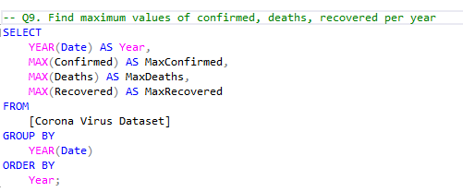
Question 8-9
In Question 8
There's zero values but we estimated the zero is null and to get the min. value greater than zero by making a condition.
Get the min for each one by year, The output equal 1 for each one and the two years so this is the smallest value.
In Question 9
Get the max for each one by year, The output equal in respect (823225, 3752, 1123456) for 2020 and (414188, 7374, 422436) for 2021.

Slide 8
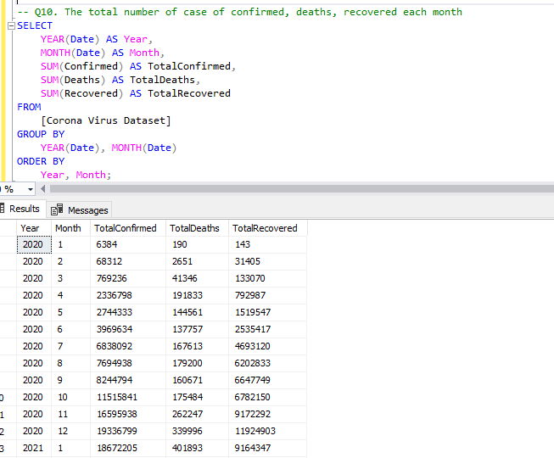
Question 10
As we see in the output the total for each case according for each month for both years.

Slide 9
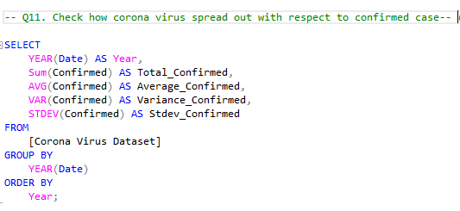
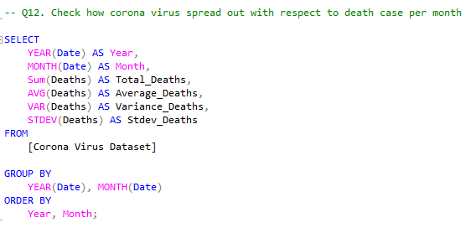
Question 11-12
using each sum, avg, var, stdev functions respectively.
The output in respect (80121099, 1508, 83792665.414442, 9153.83337266099) for 2020, (88944045, 3521, 309167104.641847, 17583.1483142766) for 2021.
using each sum, avg, var, stdev functions respectively.
The output 18 Rows in respect for first row (190, 0, 4.24857598541809, 2.06120740960683).

Slide 10
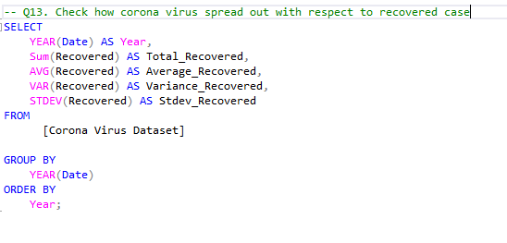
Question 13
The output in respect (50435616, 949, 52650148.2454603, 7256.04218878724) for 2020, (62653932, 2480, 219846243.060147, 14827.2129228708) for 2021.

Slide 11
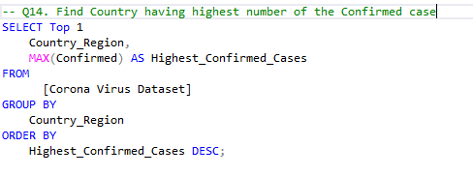
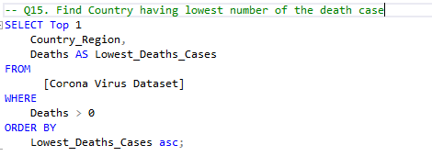
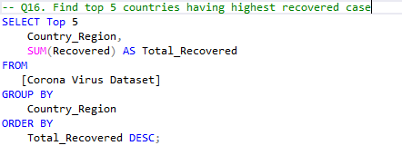
Question 14-16
The highest country is "Turkey" with Confirmed case equal "823225”.
The lowest Country is "Afghanistan", with Death case equal "1" But there are many other country with that letter but it's the first alphabetically.
The top 5 countries with there Recovered case respectively are (India,28089649), (Brazil, 15400169), (US , 6303715), (Turkey, 5202251), (Russia, 4745756).

Slide 12
Thank you!

